Slide 1
Children in Pompeii: the Invisible Majority?
Ray Laurence
01 April 2017

Slide 2
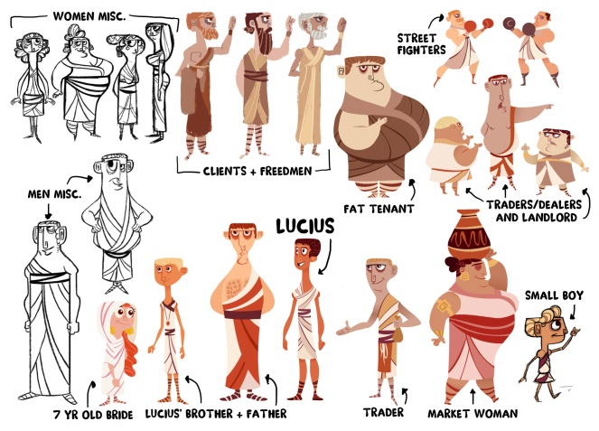
Creating Roman Children
Demography
Average life expectancy c. 30 years
Life span – not so different, but only 7% of population over 60 years old
Up to 50% of the population less than 18 years old

Slide 3
The critical problem
Sources on children and/or Roman History blind to children
Ancient writers adult males – there are no sources written by children.
Most Latin writers are in fact well over the age of 50, thus represent or idealise/demonise children.
Modern books on Pompeii lacking in children?
Houses and Society in Herculaneum and Pompeii
Roman Pompeii: Space and Society

Slide 4
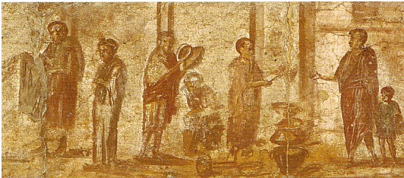
Present in imagery

Slide 5

Impetus to have children in Roman Pompeii
Fusion of Research and Impact
Growing Up and Growing Old in Ancient Rome
Cultural History of Childhood and the Family
University of Oslo – Tiny Voices Project
Academic interest in agency in the Roman world – children’s agency in the making of urbanism important, but challenging.
Please come and teach your son’s primary school class about the Romans.
Met an animator –
TED.Ed commissioned a film
Wrote animation script – recorded animation script

Slide 6


Slide 7
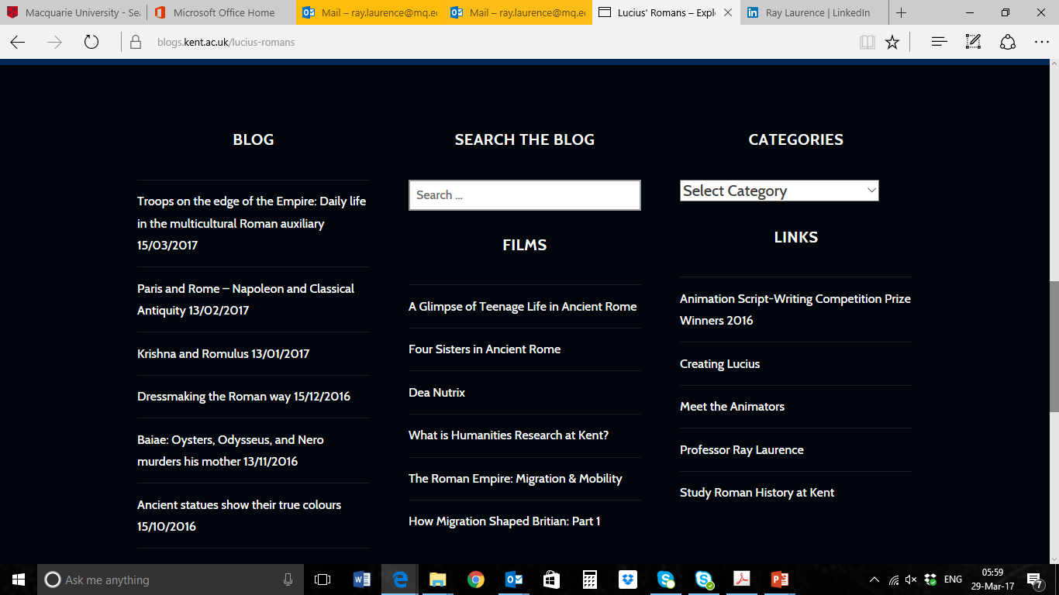
After animation made
2012-17 – 8 million YouTube views
https://blogs.kent.ac.uk/lucius-romans/

Slide 8
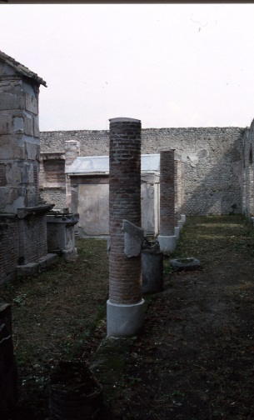
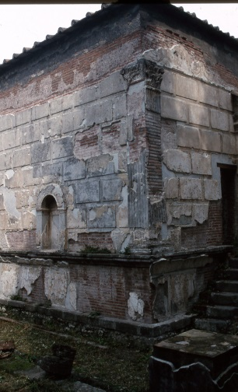
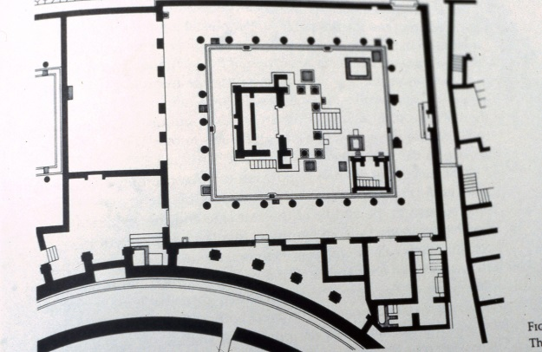
Old news – Tiny Decurions
Inscriptions point to more than one child less than 10 years old are members of the town council.
One rebuilds temple of Isis.
How might such children appear in public?

Slide 9
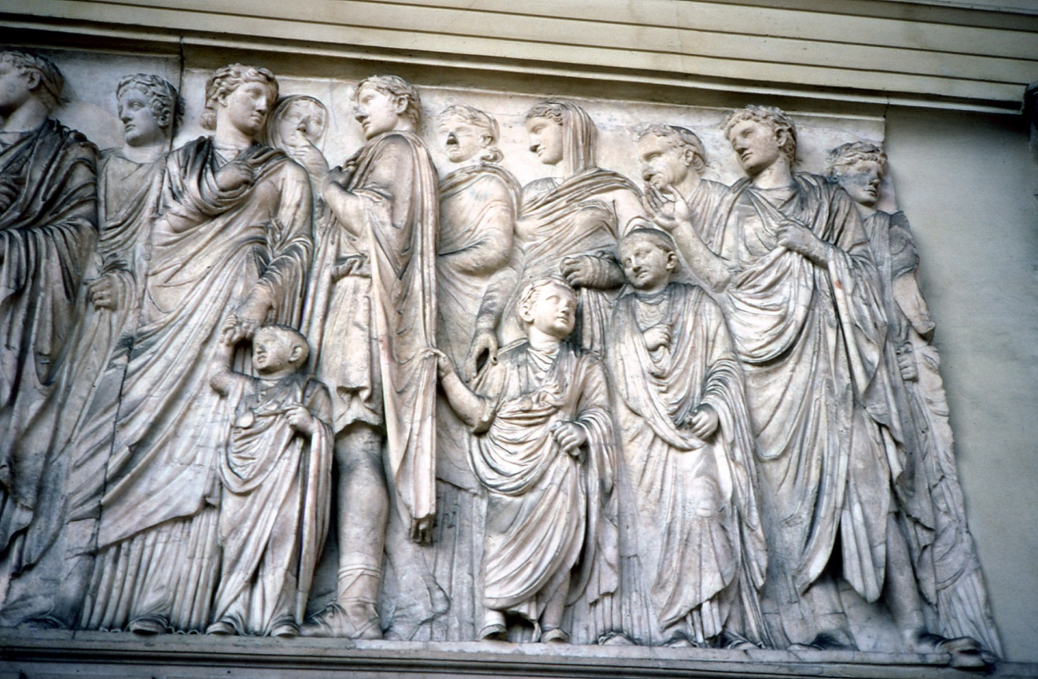
Ara Pacis – children in public art

Slide 10
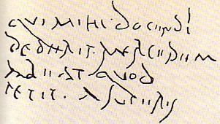
Qui mihi docendi dederit mercedem (h)abeat quod petit a superis (CIL 4.8562)
Whoever has paid me a fee for teaching, let him have what he seeks from the gods

Slide 11
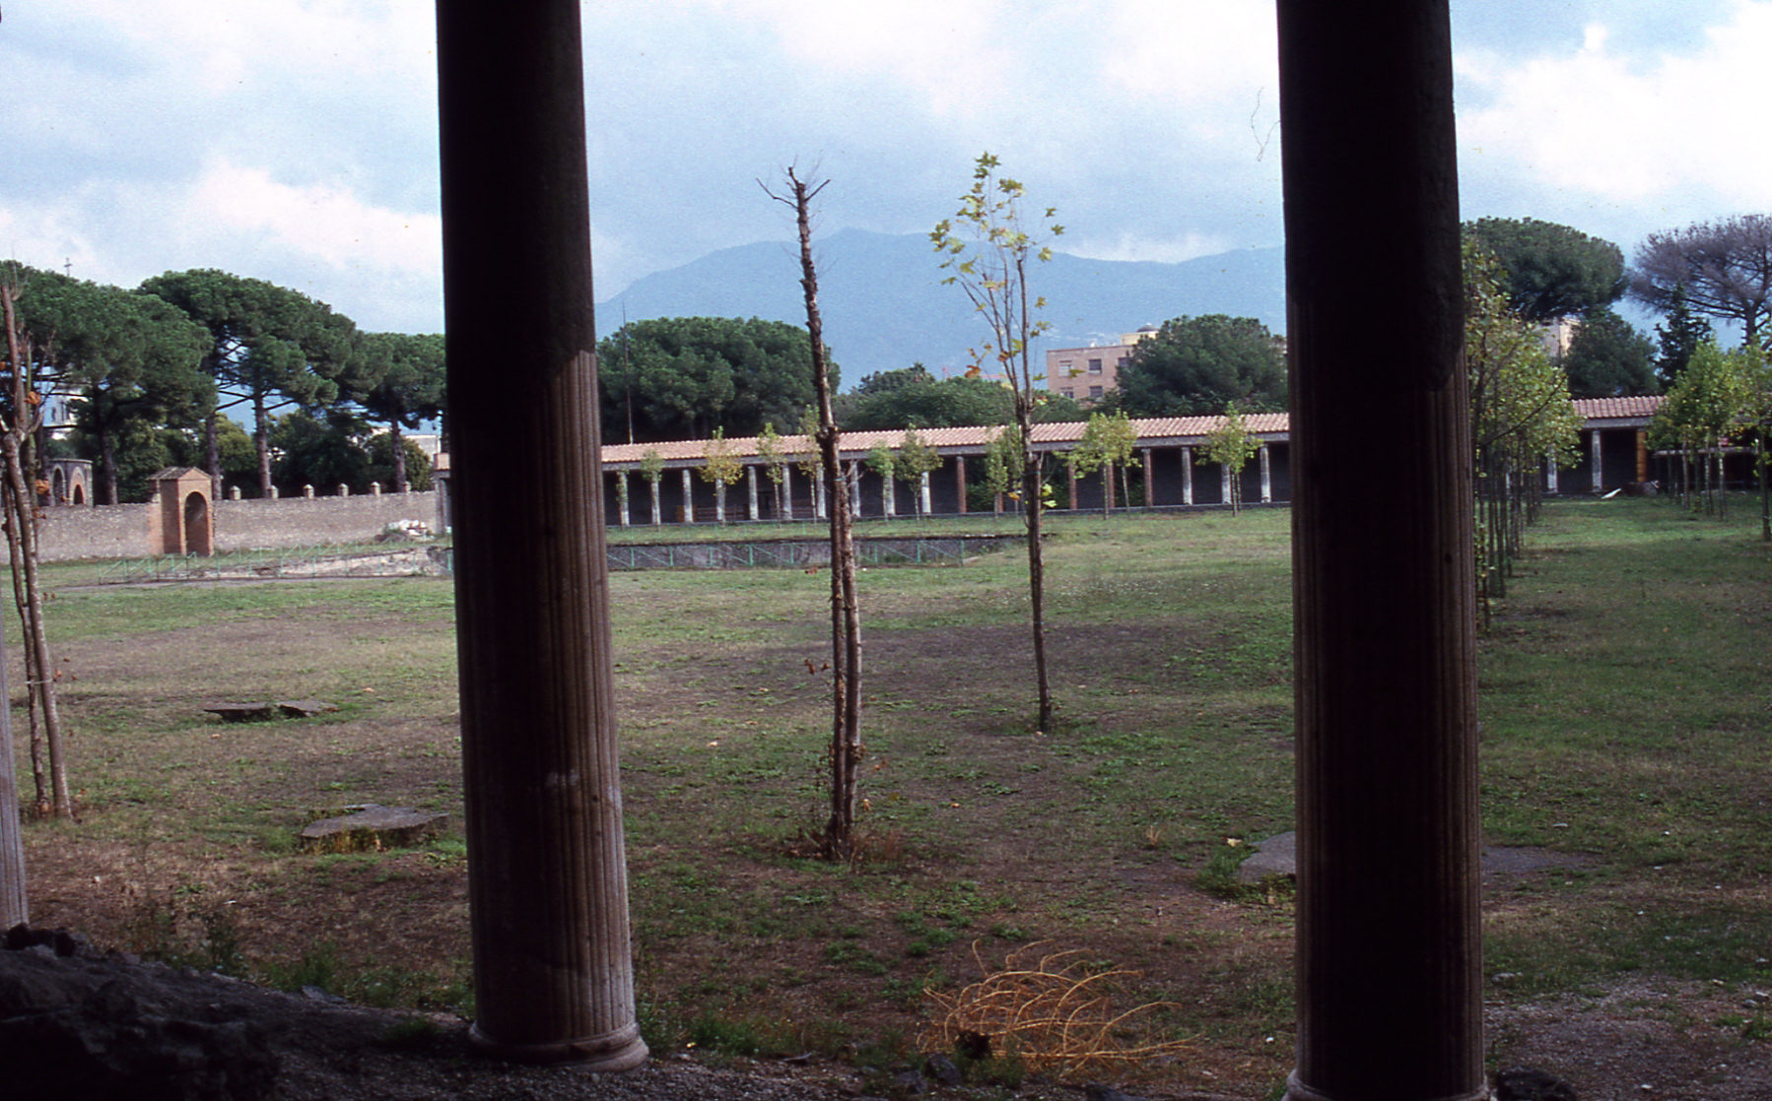
School

Slide 12
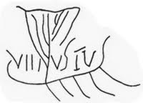
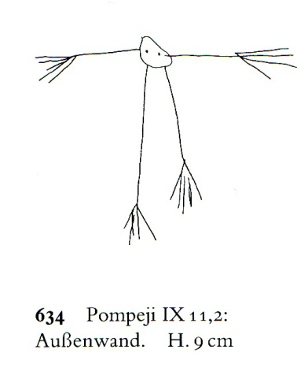
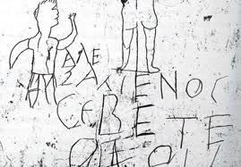
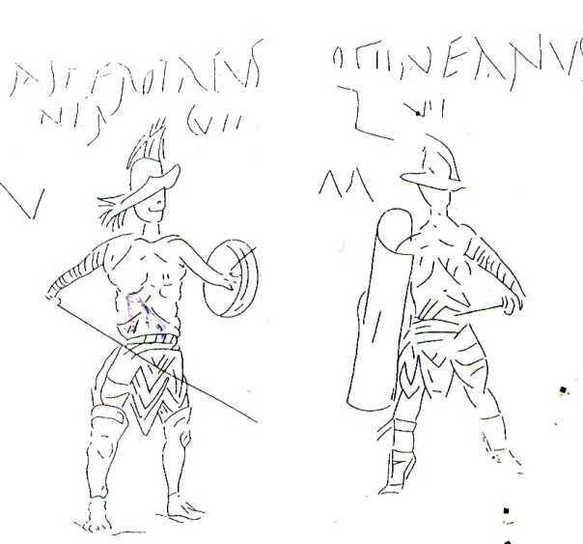
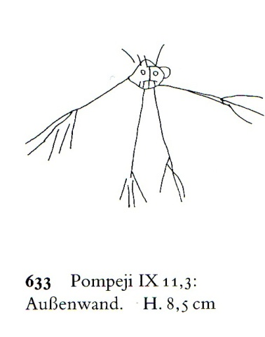
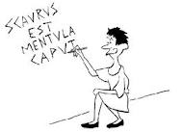
Taking graffiti seriously

Slide 13
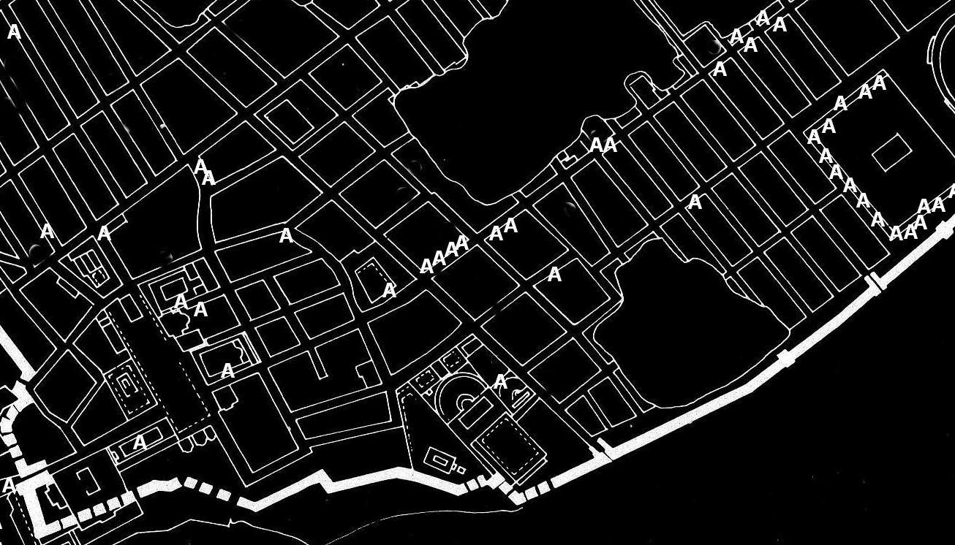
Alphabets in Public Space

Slide 14
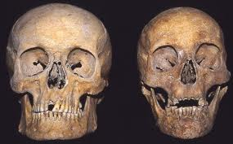
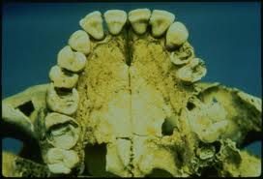
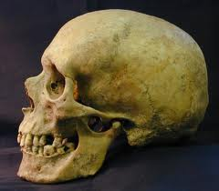
Teeth and Health in Childhood

Slide 15
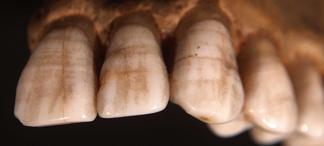

Slide 16
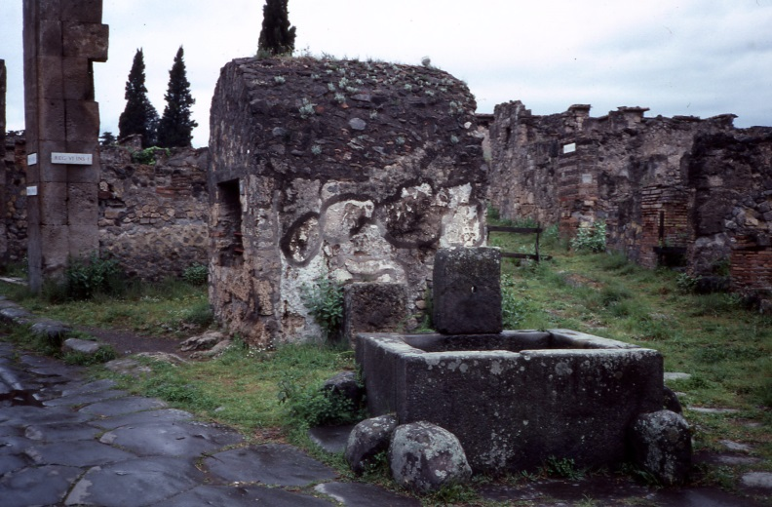
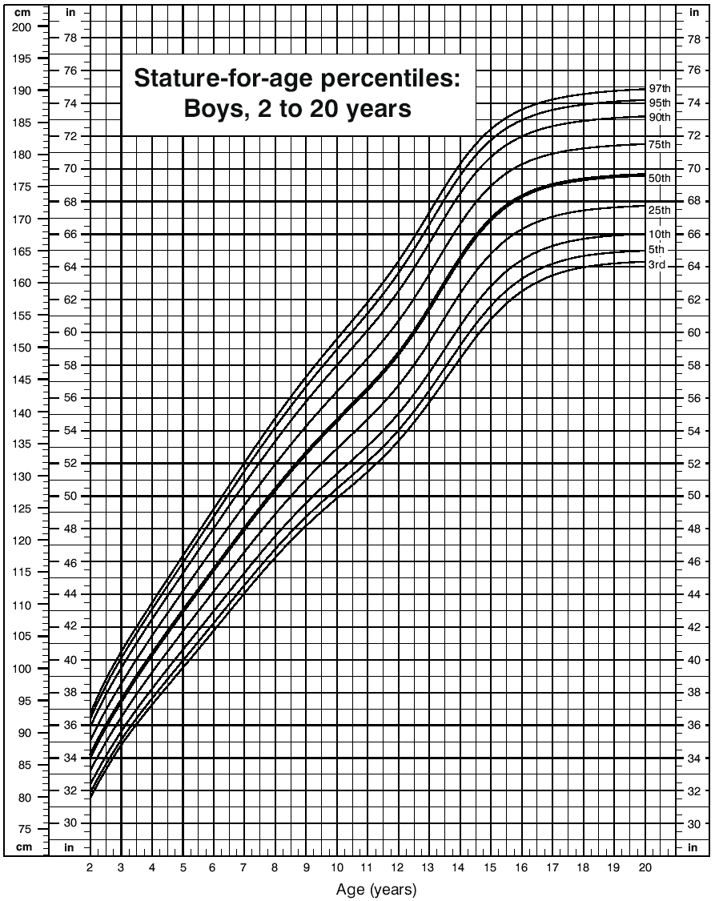
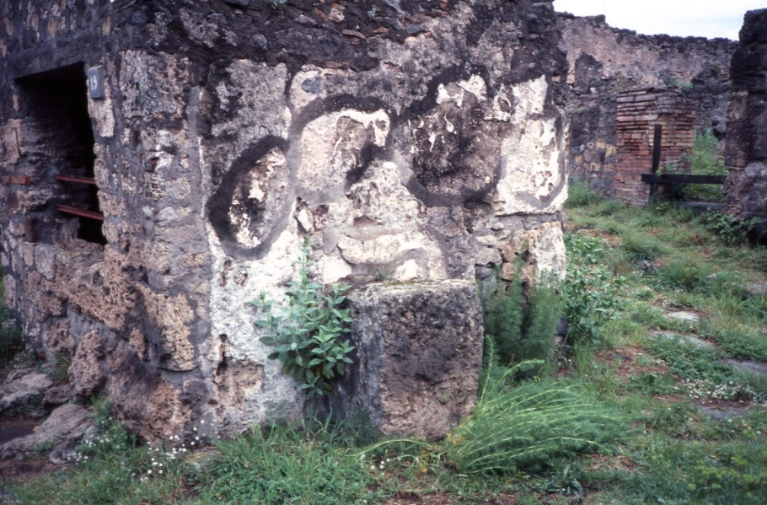
Measuring Children – Measuring Pompeii

Slide 17

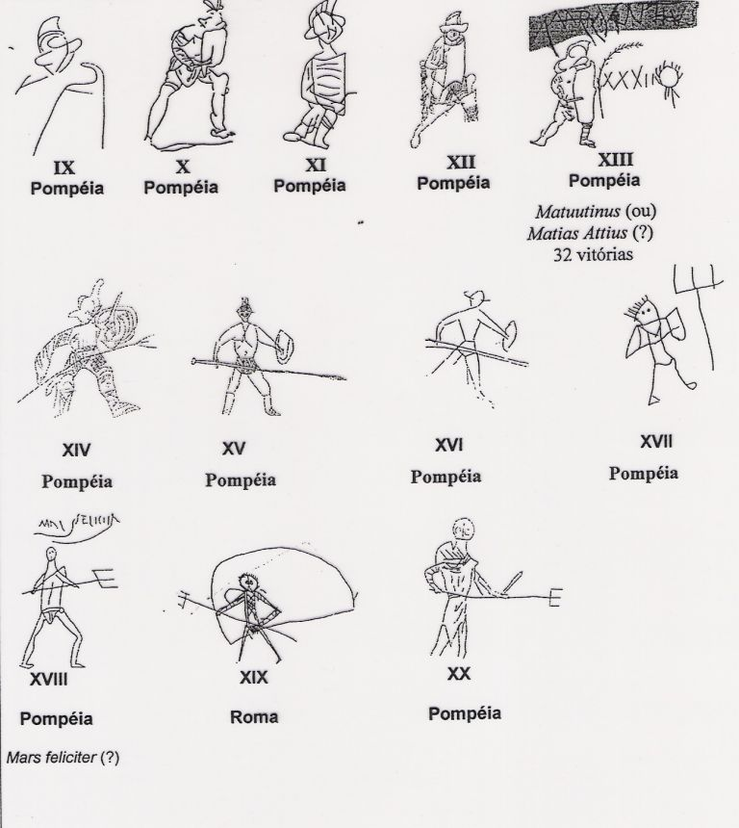
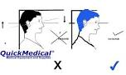
Height and the Invisible Pompeian Child
Age 6 – 106 cm tall
Age 7 – 111 cm tall
Age 8 – 117 cm tall
Age 9 – 121 cm tall
Age 10 – 126 cm tall
Age 11 – 130 cm tall
Age 12 – 134 cm tall
Age 13 – 139 cm tall
Age 14 – 145 cm tall

Slide 18
Household Lararia
Age 6 – 106 cm tall
Age 7 – 111 cm tall
Age 8 – 117 cm tall
Age 9 – 121 cm tall
Age 10 – 126 cm tall
Age 11 – 130 cm tall
Age 12 – 134 cm tall
Age 13 – 139 cm tall
Age 14 – 145 cm tall

Slide 19
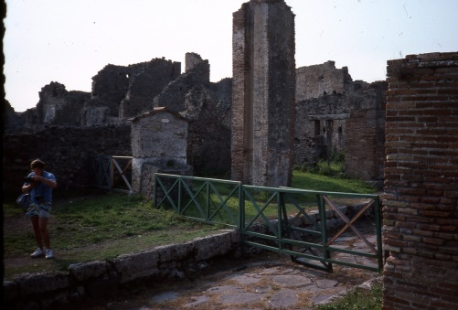
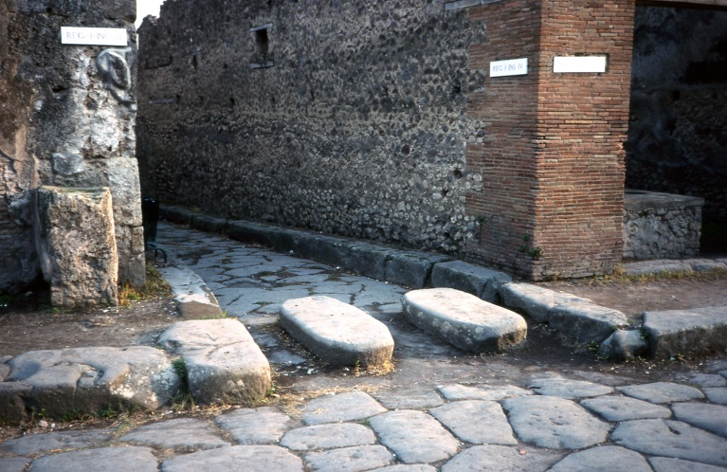
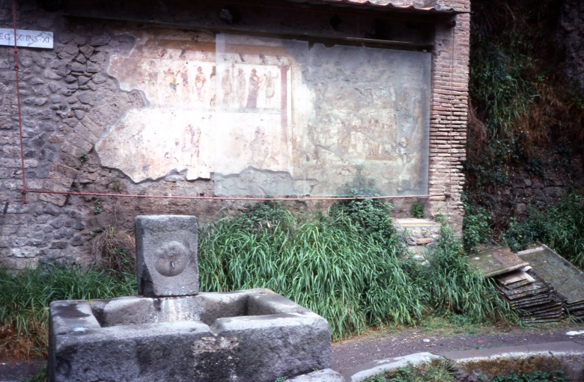
Crossroad Altars
Age 6 – 106 cm tall
Age 7 – 111 cm tall
Age 8 – 117 cm tall
Age 9 – 121 cm tall
Age 10 – 126 cm tall
Age 11 – 130 cm tall
Age 12 – 134 cm tall
Age 13 – 139 cm tall
Age 14 – 145 cm tall

Slide 20
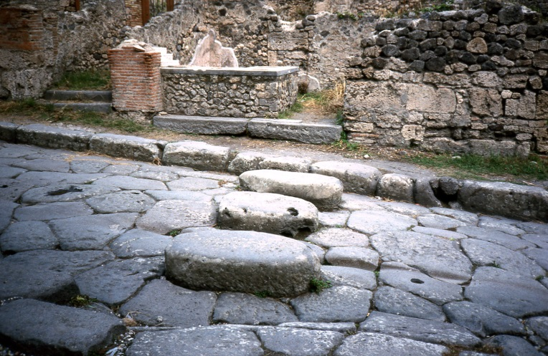
Bar Counters
Age 6 – 106 cm tall
Age 7 – 111 cm tall
Age 8 – 117 cm tall
Age 9 – 121 cm tall
Age 10 – 126 cm tall
Age 11 – 130 cm tall
Age 12 – 134 cm tall
Age 13 – 139 cm tall
Age 14 – 145 cm tall

Slide 21
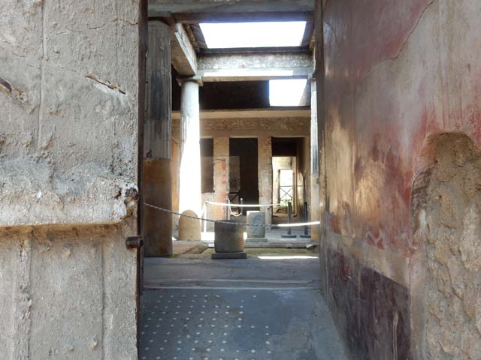
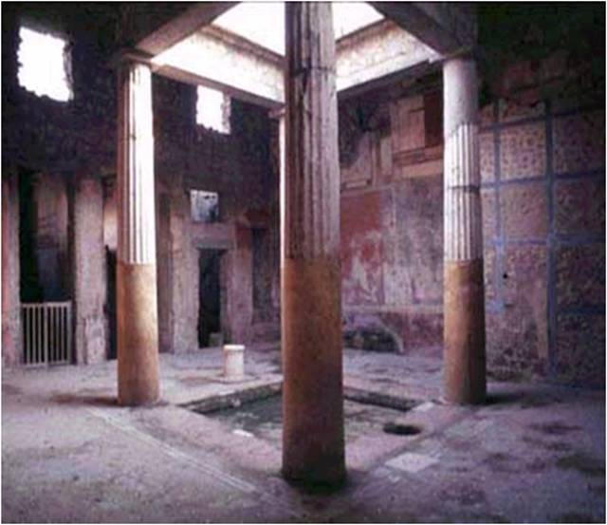
Cisterns and Safety
Age 6 – 106 cm tall
Age 7 – 111 cm tall
Age 8 – 117 cm tall
Age 9 – 121 cm tall
Age 10 – 126 cm tall
Age 11 – 130 cm tall
Age 12 – 134 cm tall
Age 13 – 139 cm tall
Age 14 – 145 cm tall

Slide 22
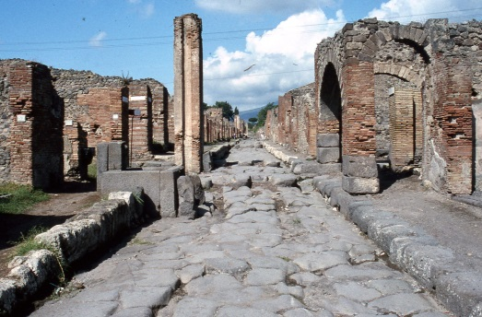
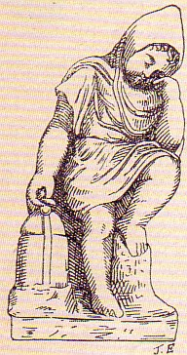
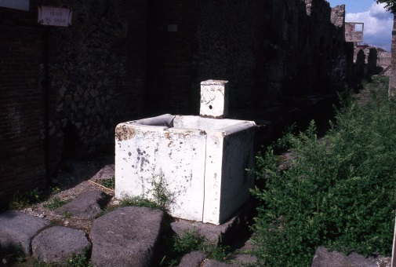
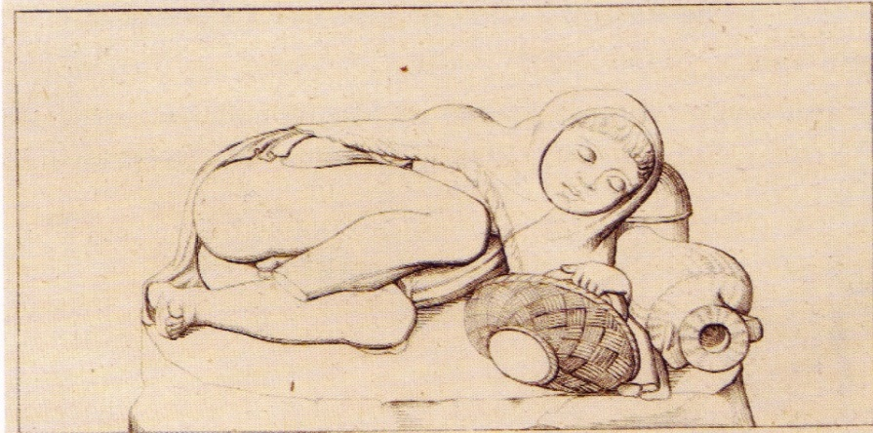
Water and Streets

Slide 23
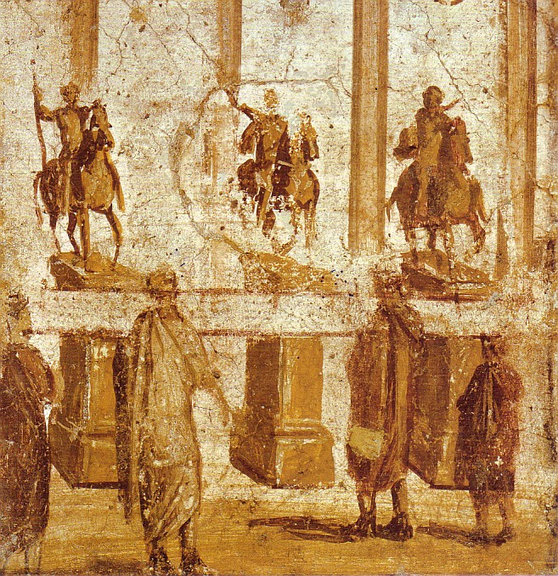
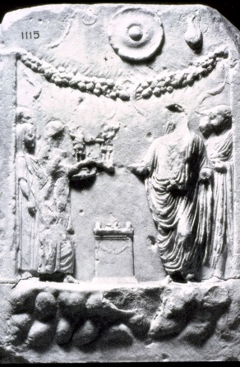
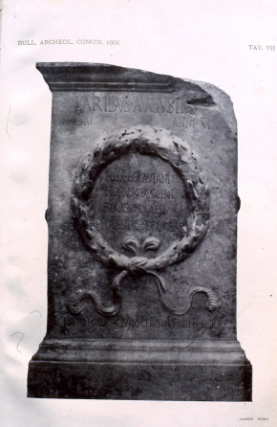
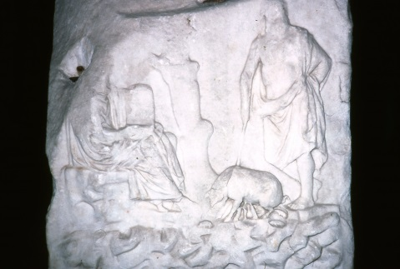
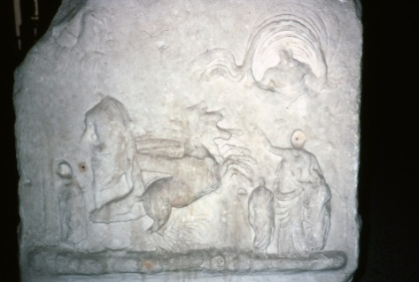
Height below

Slide 24
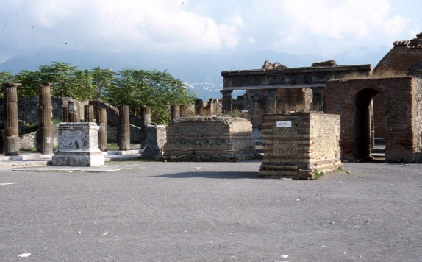
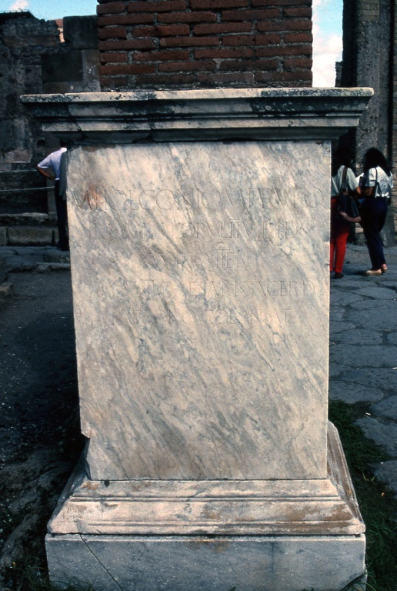
Reading and Statue Bases
Age 6 – 106 cm tall
Age 7 – 111 cm tall
Age 8 – 117 cm tall
Age 9 – 121 cm tall
Age 10 – 126 cm tall
Age 11 – 130 cm tall
Age 12 – 134 cm tall
Age 13 – 139 cm tall
Age 14 – 145 cm tall

Slide 25


To read more about this

Slide 26


Slide 27
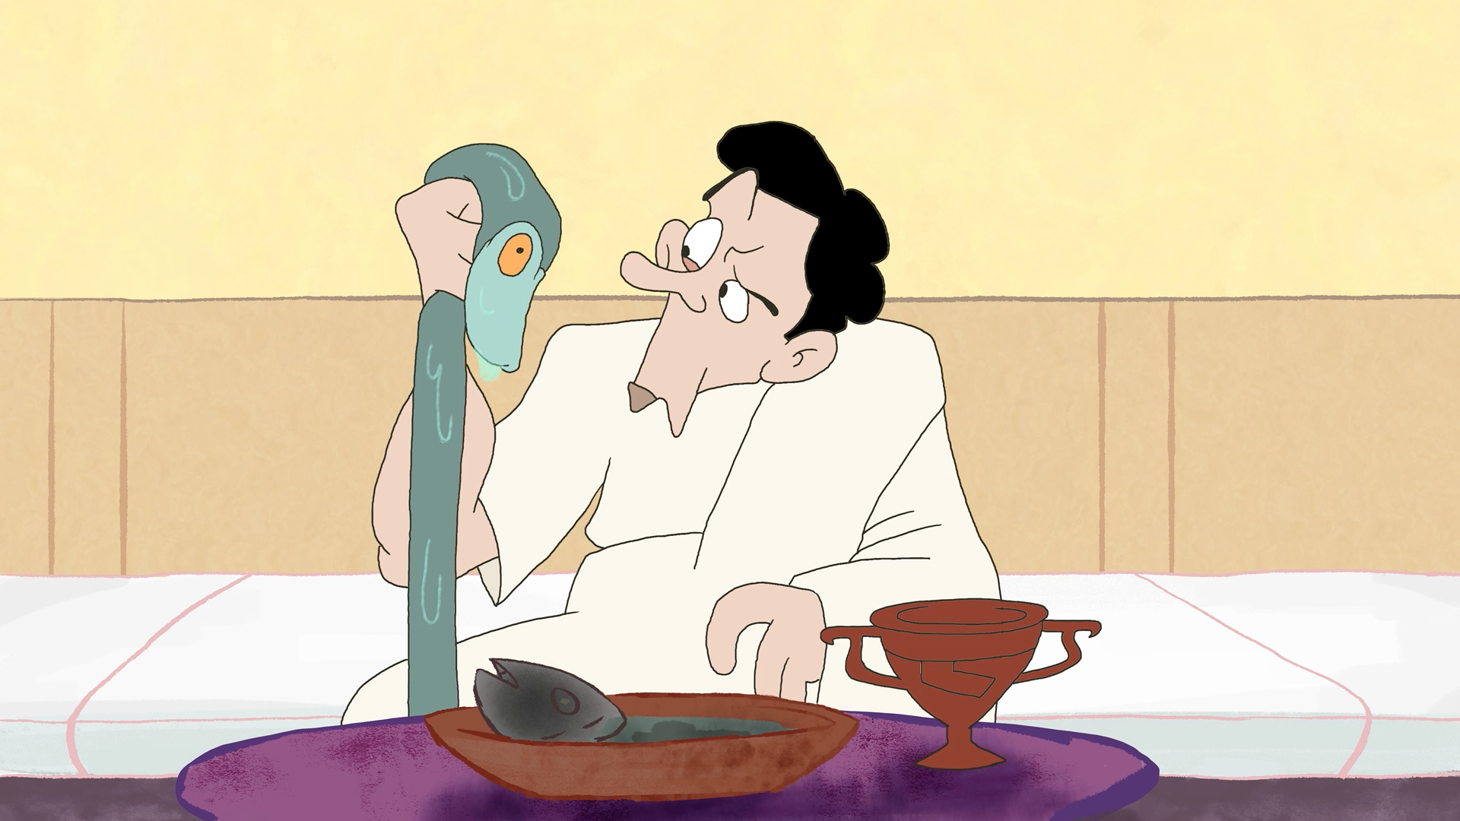

Slide 28
http://youtu.be/juWYhMoDTN0

